Slide 1
Hashing

Slide 2
There are several searching techniques like linear search, binary search, search trees etc.
In these techniques, time taken to search any particular element depends on the total number of elements.
Linear Search takes O(n) time to perform the search in unsorted arrays consisting of n elements.
Binary Search takes O(logn) time to perform the search in sorted arrays consisting of n elements.
It takes O(logn) time to perform the search in Binary Search Tree consisting of n elements.
To guarantee O(logn) search time, height balancing is required in BST(i.e. AVL)
The main drawback of these techniques is-
As the number of elements increases, time taken to perform the search also increases.
This becomes problematic when total number of elements become too large.
Hashing
,
Hashing is a well-known technique to search any particular record among several records.
It minimizes the number of comparisons while performing the search.
Advantage-
Unlike other searching techniques,
Hashing is extremely efficient.
The time taken by it to perform the search does not depend upon the total number of records.
It completes the search with constant time complexity O(1).

Slide 3
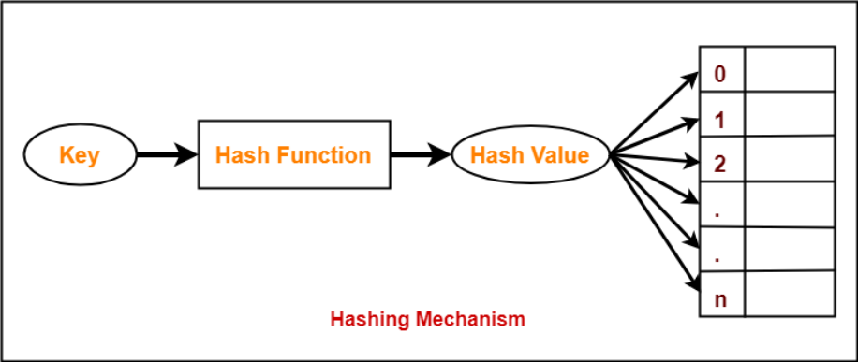
Hashing Mechanism-
In hashing,
An array data structure called as Hash table is used to store the data items.
Based on the hash key value, data items are inserted into the hash table.
Hash Key Value-
Hash key value is a special value that serves as an index for a data item.
It indicates where the data item should be stored in the hash table.
Hash key value is generated using a hash function.

Slide 4
Hash Function-
Hash function takes the data item as an input and returns a small integer value as an output.
The small integer value is called as a hash value.
Hash value of the data item is then used as an index for storing it into the hash table.
Types of Hash Functions-
There are various types of hash functions available such as-
Mid Square Hash Function
Division Hash Function
Folding Hash Function etc
It depends on the user which hash function he wants to use.
Hash function is a function that maps any big number or string to a small integer value.
Properties of Hash Function-
The properties of a good hash function are-
Easy to compute: It should be easy to compute and must not become an algorithm in itself.
Uniform distribution: It should provide a uniform distribution across the hash table and should not result in clustering.
Less collisions: Collisions occur when pairs of elements are mapped to the same hash value. These should be avoided.

Slide 5
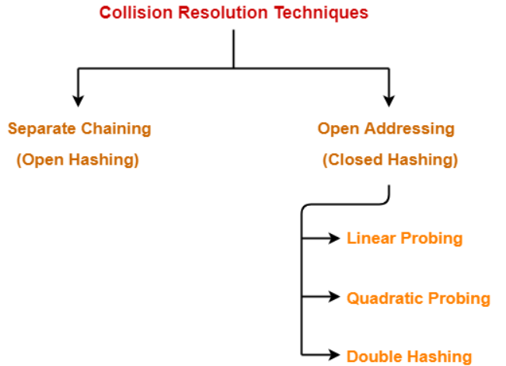
Collision in Hashing-
In hashing,
Hash function is used to compute the hash value for a key.
Hash value is then used as an index to store the key in the hash table.
Hash function may return the same hash value for two or more keys.
When the hash value of a key maps to an already occupied bucket of the hash table, it is called as a Collision.
Collision Resolution Techniques-
Collision Resolution Techniques are the techniques
used for resolving or handling the collision.

Slide 6
Separate Chaining-
To handle the collision,
This technique creates a linked list to the slot for which collision occurs.
The new key is then inserted in the linked list.
These linked lists to the slots appear like chains.
That is why, this technique is called as separate chaining.
Time Complexity-
For Searching-
In worst case, all the keys might map to the same bucket of the hash table.
In such a case, all the keys will be present in a single linked list.
Sequential search will have to be performed on the linked list to perform the search.
So, time taken for searching in worst case is O(n).
For Deletion-
In worst case, the key might have to be searched first and then deleted.
In worst case, time taken for searching is O(n).
So, time taken for deletion in worst case is O(n).

Slide 7
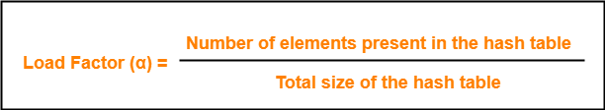
The Hash Function is usually a composition of two maps:
Hash code map
Keys → Integer
Compression map
Integer → A[0……m-1]
Load Factor (α)-
Load factor (α) is defined as-
If Load factor (α) = constant, then time complexity of Insert, Search, Delete = Θ(1)

Slide 8
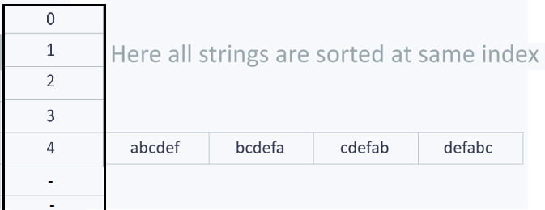
Let us understand the need for a good hash function. Assume that you have to store strings in the hash table by using the hashing technique {“abcdef”, “bcdefa”, “cdefab” , “defabc” }.
To compute the index for storing the strings, use a hash function that states the following:
The index for a specific string will be equal to the sum of the ASCII values of the characters modulo 593.
As 593 is a prime number, it will reduce the possibility of indexing different strings (collisions). It is recommended that you use prime numbers in case of modulo.
The ASCII values of a, b, c, d, e, and f are 97, 98, 99, 100, 101, and 102 respectively. Since all the strings contain the same characters with different permutations, the sum will 597.
The hash function will compute the same index for all the strings and the strings will be stored in the hash table in the following format.
As the index of all the strings is the same, you can create a list on that index and insert all the strings in that list.
Here, it will take O(n) time (where n is the number of strings) to access a specific string. This shows that the hash function is not a good hash function.

Slide 9
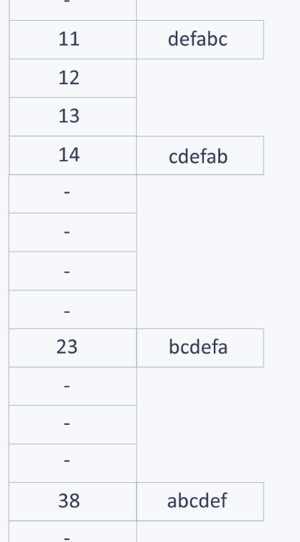
Let’s try a different hash function. The index for a specific string will be equal to sum of ASCII values of characters multiplied by their respective order in the string after which it is modulo with 2069 (prime number).
String Hash function Index
abcdef (97*1 + 98*2 + 99*3 + 100*4 + 101*5 + 102*6)%2069 38 bcdefa (98*1 + 99*2 + 100*3 + 101*4 + 102*5 + 97*6)%2069 23 cdefab (99*1 + 100*2 + 101*3 + 102*4 + 97*5 + 98*6)%2069 14 defabc (100*1 + 101*2 + 102*3 + 97*4 + 98*5 + 99*6)%2069 11

Slide 10
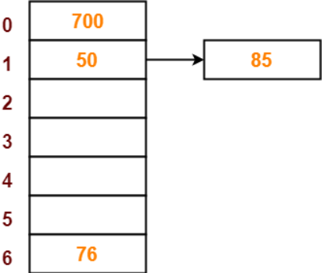
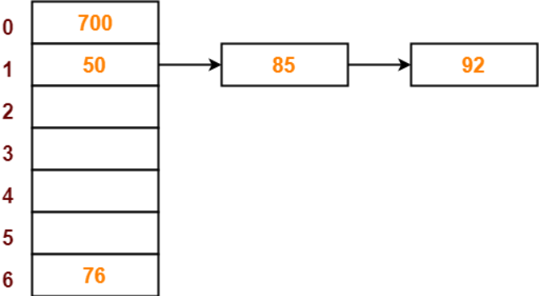
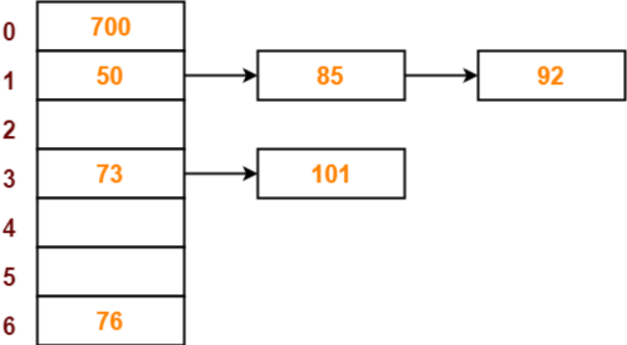
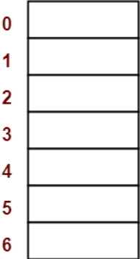
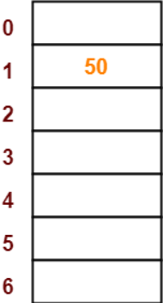
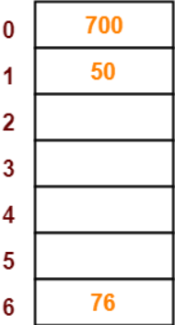
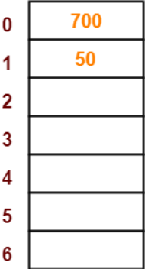
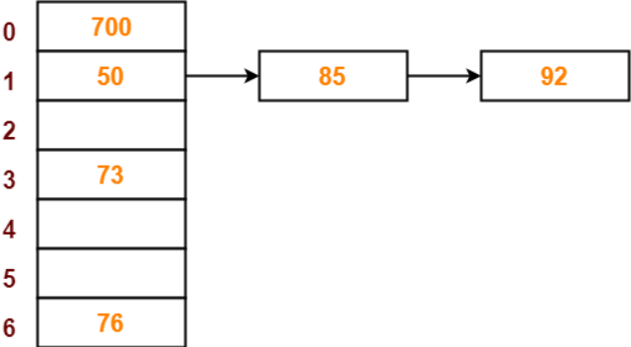
Problem-
Using the hash function ‘key mod 7’, insert the following sequence of keys in the hash table-
50, 700, 76, 85, 92, 73 and 101
Use separate chaining technique for collision resolution.
Step-01:
Draw an empty hash table.
For the given hash function, the possible range of hash values is [0, 6].
So, draw an empty hash table consisting of 7 buckets as-
Step-02:
Insert the given keys in the hash table one by one.
The first key to be inserted in the hash table = 50.
Bucket of the hash table to which key 50 maps = 50 mod 7 = 1.
So, key 50 will be inserted in bucket-1 of the hash table as-
700 maps = 700 mod 7 = 0
76 maps = 76 mod 7 = 6.
85 maps = 85 mod 7 = 1.
Since bucket-1 is already occupied, so collision occurs.
92 maps = 92 mod 7 = 1.
73 maps = 73 mod 7 = 3.
101 maps = 101 mod 7 = 3.

Slide 11
Open Addressing-
In open addressing,
Unlike separate chaining, all the keys are stored inside the hash table.
No key is stored outside the hash table.
Techniques used for open addressing are-
Linear Probing
Quadratic Probing
Double Hashing
Insert Operation-
Hash function is used to compute the hash value for a key to be inserted.
Hash value is then used as an index to store the key in the hash table.
In case of collision,
Probing is performed until an empty bucket is found.
Once an empty bucket is found, the key is inserted.
Probing is performed in accordance with the technique used for open addressing.

Slide 12
Search Operation-
To search any particular key,
Its hash value is obtained using the hash function used.
Using the hash value, that bucket of the hash table is checked.
If the required key is found, the key is searched.
Otherwise, the subsequent buckets are checked until the required key or an empty bucket is found.
The empty bucket indicates that the key is not present in the hash table.
Delete Operation-
The key is first searched and then deleted.
After deleting the key, that particular bucket is marked as “deleted”.
NOTE-
During insertion, the buckets marked as “deleted” are treated like any other empty bucket.
During searching, the search is not terminated on encountering the bucket marked as “deleted”.
The search terminates only after the required key or an empty bucket is found.

Slide 13
1. Linear Probing-
In linear probing,
When collision occurs, we linearly probe for the next bucket.
We keep probing until an empty bucket is found.
Advantage-
It is easy to compute.
Disadvantage-
The main problem with linear probing is clustering.
Many consecutive elements form groups.
Then, it takes time to search an element or to find an empty bucket.
Time Complexity- Worst time to search an element in linear probing is O (table size).
This is because-
Even if there is only one element present and all other elements are deleted.
Then, “deleted” markers present in the hash table makes search the entire table.

Slide 14
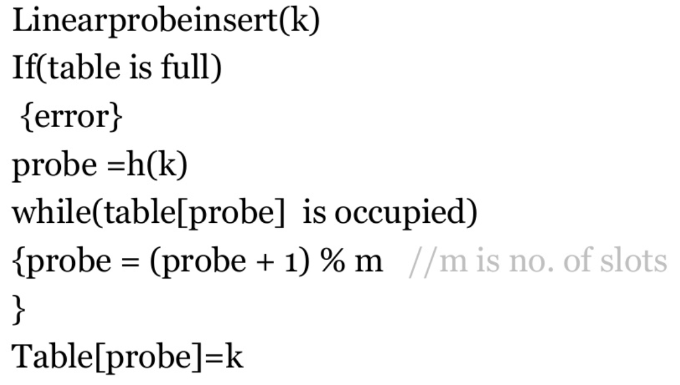
Algorithm: Linear Probing

Slide 15
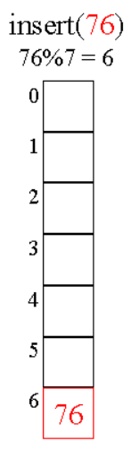
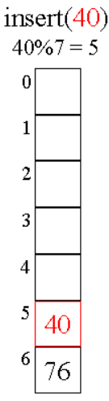
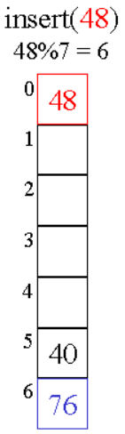
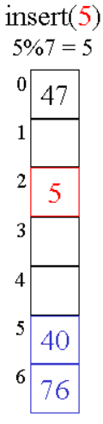
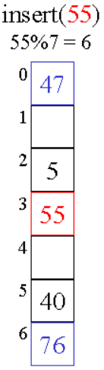
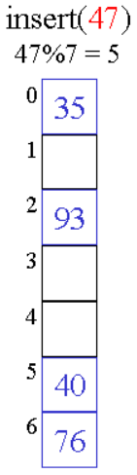
2. Quadratic Probing-
In quadratic probing,
When collision occurs, we probe for i²‘th bucket in i^{th} iteration.
We keep probing until an empty bucket is found.
let hash(x) be the slot index computed using hash function.
If slot hash(x) % S is full, then we try (hash(x) + 1*1) % S
If (hash(x) + 1*1) % S is also full, then we try (hash(x) + 2*2) % S
If (hash(x) + 2*2) % S is also full, then we try (hash(x) + 3*3) % S

Slide 16
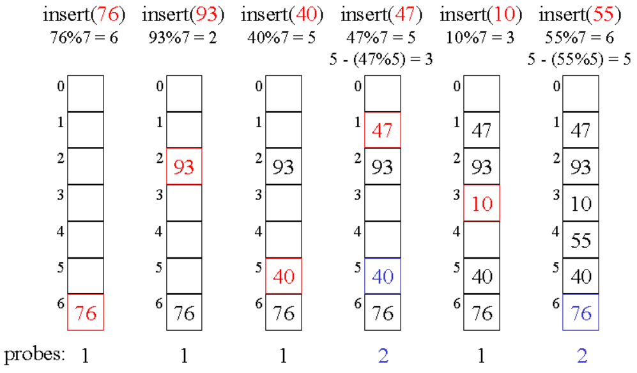
3. Double Hashing-
In double hashing,
We use another hash function hash2(x) and look for i * hash2(x) bucket in i^{th} iteration.
It requires more computation time as two hash functions need to be computed.
let hash(x) be the slot index computed using hash function.
If slot hash(x) % S is full, then we try (hash(x) + 1*hash2(x)) % S
If (hash(x) + 1*hash2(x)) % S is also full, then we try (hash(x) + 2*hash2(x)) % S
If (hash(x) + 2*hash2(x)) % S is also full, then we try (hash(x) + 3*hash2(x)) % S
H1(x)=k%7
H2(x)=R-(k%R)
H2(x)=5-(k%5)
Where R is prime no, always less than table size

Slide 17
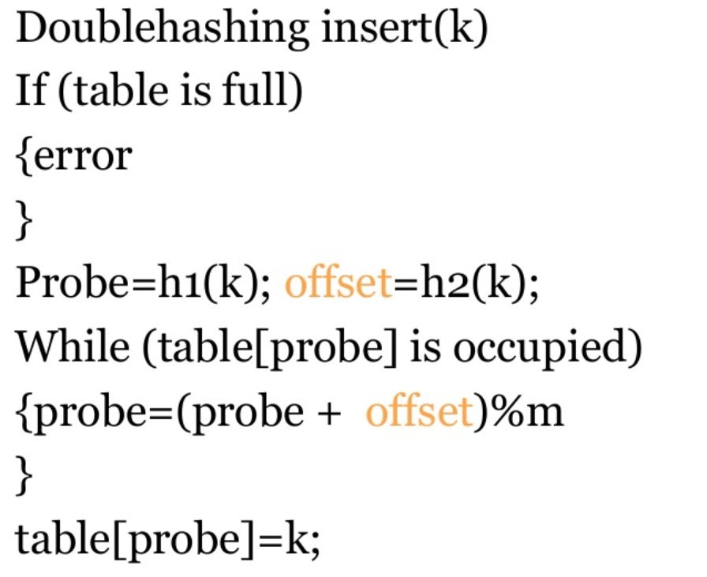
Algorithm: Double Hashing

Slide 18
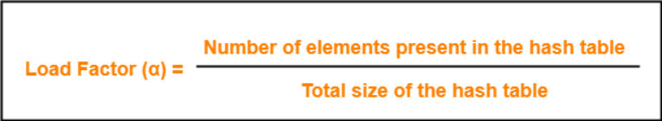
Conclusions-
Linear Probing has the best cache performance but suffers from clustering.
Quadratic probing lies between the two in terms of cache performance and clustering.
Double caching has poor cache performance but no clustering.
Load Factor (α)-
Load factor (α) is defined as-
In open addressing, the value of load factor always lie between 0 and 1.
This is because-
In open addressing, all the keys are stored inside the hash table.
So, size of the table is always greater or at least equal to the number of keys stored in the table.

Slide 19
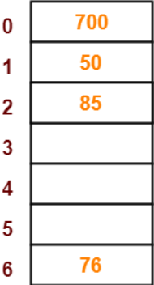
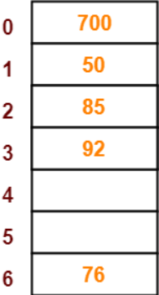
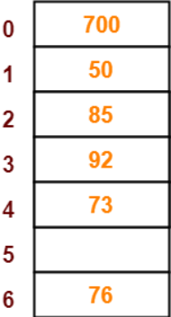
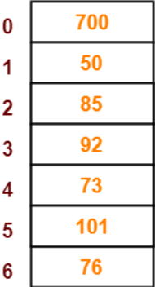
Problem-
Using the hash function ‘key mod 7’, insert the following sequence of keys in the hash table-
50, 700, 76, 85, 92, 73 and 101
Use linear probing technique for collision resolution.
Step-01:
Draw an empty hash table.
For the given hash function, the possible range of hash values is [0, 6].
So, draw an empty hash table consisting of 7 buckets as-
50 maps = 50 mod 7 = 1.
700 maps = 700 mod 7 = 0.
76 maps = 76 mod 7 = 6.
85 maps = 85 mod 7 = 1.
Since bucket-1 is already occupied, so collision occurs.
To handle the collision, linear probing technique keeps probing linearly until an empty bucket is found.
The first empty bucket is bucket-2. So, key 85 will be inserted in bucket-2 of the hash table as-
92 mod 7 = 1
73 mod 7 = 3
101 mod 7 = 3

Slide 20
Problem-
Using the hash function ‘key mod 7’, insert the following sequence of keys in the hash table-
50, 700, 76, 85, 92, 73 and 101
Use quadratic probing technique for collision resolution.
i | HT(i)
0 | 700
1 | 50
2 | 85
3 | 73
4 | 92
5 | 101
6 | 76
50%7 =1
700%7 =0
76%7 =6
85%7 =1 collision, (1+1*1)%7=2
92%7 =4
73%7 =3
101%7 =3 collision, (3+1*1)%7=4 collision, (3+2*2)%7=0 collision
(3+3*3)%7=5

Slide 21
Problem-
Using the hash function h1(k)=k mod 13, h2(k)= 8-(k mod 8) insert the following sequence of keys in the hash table-
18, 41, 22, 44, 59, 32, 31, 73
0 | 44
1
2 | 41
3 | 73
4
5 | 18
6 | 32
7 | 59
8 | 31
9 | 22
10
11
12
18%13 =5
41%13 =2
22%13 =9
44%13 =5 collision, (5+1*{8-(44%8)})%13=9 collision,
(5+2*{8-(44%8)})%13=0
59%13 =7
32%13 =6
31%13 =5 collision, (5+1*{8-(31%8)})%13=6 collision
(5+2*{8-(31%8)})%13=7 collision
(5+3*{8-(31%8)})%13=8
73%13 =8 collision, (8+1*{8-(73%8)})%13=2 collision
(8+2*{8-(73%8)})%13=9 collision
(8+3*{8-(73%8)})%13=3

Slide 22
How will you design a hash function for storing following mobile numbers?
9826098260
9977993322
9737343244
9993433466
JAVA
String s = “ABC";
int hashCode = s.hashCode();
s.charAt(0) * 31n-1 + s.charAt(1) * 31n-2 + ... + s.charAt(n-1)
"ABC" = 'A' * 312 + 'B' * 31 + 'C' = 65 * 312 + 66 * 31 + 67 = 64578
98+26+09+82+60 or 98260+98260 then k % prime_no
98*1+26*2+09*3+82*4+62*5 then k % prime_no
we can make use of standard quadratic equation
What if h2(x) evaluates zero..?

Slide 23
Practice problem : H1(x)= x mod 10, H2(x)= 7 – (x mod 7)
89, 18, 49, 58, 69
Que – 1. Given the following input (4322, 1334, 1471, 9679, 1989, 6171, 6173, 4199) and the hash function x mod 10, which of the following statements are true? (GATE CS 2004) i. 9679, 1989, 4199 hash to the same value ii. 1471, 6171 has to the same value iii. All elements hash to the same value iv. Each element hashes to a different value (A) i only (B) ii only (C) i and ii only (D) iii or iv
Que – 2. The keys 12, 18, 13, 2, 3, 23, 5 and 15 are inserted into an initially empty hash table of length 10 using open addressing with hash function h(k) = k mod 10 and linear probing. What is the resultant hash table?

Slide 24
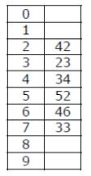
Que – 3. A hash table of length 10 uses open addressing with hash function h(k)=k mod 10, and linear probing. After inserting 6 values into an empty hash table, the table is as shown below. Which one of the following choices gives a possible order in which the key values could have been inserted in the table? (A) 46, 42, 34, 52, 23, 33 (B) 34, 42, 23, 52, 33, 46 (C) 46, 34, 42, 23, 52, 33 (D) 42, 46, 33, 23, 34, 52
Que – 4. How many different insertion sequences of the key values using the same hash function and linear probing will result in the hash table given in Question 3 above? (A) 10 (B) 20 (C) 30 (D) 40

Slide 25
Que – 5. Consider a hash table with 100 slots. Collisions are resolved using chaining. Assuming simple uniform hashing, what is the probability that the first 3 slots are unfilled after the first 3 insertions? (GATE-CS-2014) (A) (97 × 97 × 97)/100^3 (B) (99 × 98 × 97)/100^3 (C) (97 × 96 × 95)/100^3 (D) (97 × 96 × 95)/(3! × 100^3)
Que – 6. Which one of the following hash functions on integers will distribute keys most uniformly over 10 buckets numbered 0 to 9 for i ranging from 0 to 2020? (GATE-CS-2015) (A) h(i) =i^2 mod 10 (B) h(i) =i^3 mod 10 (C) h(i) = (11 ∗ i^2) mod 10 (D) h(i) = (12 ∗ i) mod 10

